Slide 1
BAYESIAN NETWORKS
Ms. Swati Mali
swatimali@somaiya.edu

Slide 2
Outline
Uncertainty
Bayesian Networks
  Syntax
  Global Semantics
  Local Semantics
Constructing Bayesian Networks

Slide 3
Characteristics of knowledge
Voluminous
Hard to characterise
Constantly changing
Uncertainty means that many of the simplifications that are possible with deductive inference are no longer valid.

Slide 4
Example- taxi driver
Performance measure
-2 per breaking signal
+10 reaching in time
-1 per missed speed breaker
+8 choosing optimal route
-6 reaching too early
Plan 1- leaving 100 minutes early for a distance of 10 kms and driving at reasonable speed
Plan 2 – leaving 300 minutes early
Plan 3- leaving 60 mins early and drive like crazy

Slide 5

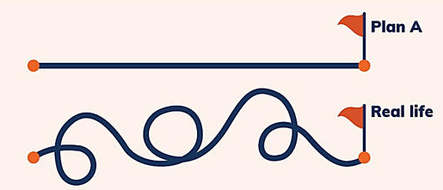
Problem and plans

Slide 6
Problem and plans
Consider a grocery delivery system like BigBasket which is supposed to deliver goods as per the chosen slots to the customers during current lockdown phase. Give some plans for their procurement and delivery work considering uncertainties in the real world.

Slide 7
Uncertainty
Car breaks down
Runs out of fuel,
Agent gets into an accident,
There are accidents on the bridge,
Someone had wrong inventory and now the ordered goods are not in warehouse
Strike/disruption on the way to warehouse/delivery
…….
None of these conditions can be deduced, so the plan's success cannot be inferred.

Slide 8
Example - Handling uncertain knowledge
∀p Symptom(p, Toothache) ➔ Disease(p, Cavity) . ➔ Wrong
Not all patients with toothaches have cavities
∀ p Symptom(p, Toothache) ➔ Disease(p, Cavity) V Disease(p, GumDisease) C' Disease(p, Abscess) . . .
Almost unlimited list of possible causes
∀ p Disease(p, Cavity) ➔ Symptom(p, toothache) ➔ Wrong
Not all cavities cause pain. Only logically exhaustive list may help.
Still there’s possibility that a patient might have a toothache and a cavity that are unconnected.

Slide 9
Reasons which summarize uncertainty
Laziness: It is too much work to list the complete set of antecedents or consequents needed to ensure an exceptionalness rule and too hard to use such rules.
Theoretical ignorance: There may not any complete theory for the domain. E.g. Medical Science
Practical ignorance: Even if we know all the rules, we might be uncertain about the problem instance in hand. E.g. some particular patient because not all the necessary tests have been or can be run.
These reasons are inescapable in complex, dynamic, or inaccessible worlds.

Slide 10
Uncertainty … Contd
Same theories as medical science may be applicable to law, business, design, automobile repair, gardening, dating, and so on.
The agent's knowledge can at best provide only a degree of belief in the relevant sentences.
Solution - Main tool for dealing with degrees of belief will be probability theory, which assigns to each sentence a numerical degree of belief between 0 and 1.
Probability provides a way of summarizing the uncertainty that comes from our laziness and ignorance.
E.g. patient has a cavity if he or she has a toothache.

Slide 11
Decision Theory
Utility theory says that every state has a degree of usefulness, or utility, to an agent and that the agent will prefer states with higher utility.
Decision theory = probability theory + utility theory .

Slide 12
Probabilistic Agent
sensors
?
environment
agent
actuators
I believe that the sun
will still exist tomorrow
with probability 0.999999
and that it will be a sunny
with probability 0.6

Slide 13
Problem
At a certain time t, the KB of an agent is some collection of beliefs
At time t the agent’s sensors make an observation that changes the strength of one of its beliefs
How should the agent update the strength of its other beliefs?

Slide 14
Purpose of Bayesian Networks
Bayesian network represents the dependencies among variables and to give a concise specification of any full joint probability distribution.
Facilitate the description of a collection of beliefs by making explicit causality relations and conditional independence among beliefs
Provide a more efficient way (than by using joint distribution tables) to update belief strengths when new evidence is observed

Slide 15
Other Names
Belief networks
Probabilistic networks
Causal networks

Slide 16
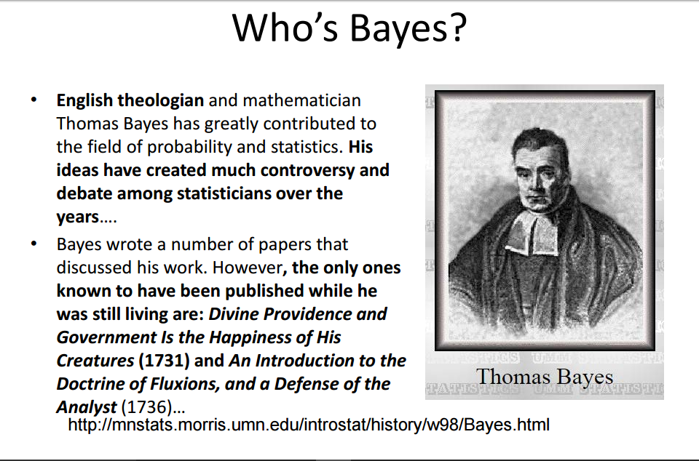
1702-1761

Slide 17
Bayesian Networks
A simple, graphical notation for conditional independence assertions resulting in a compact representation for the full joint distribution
Syntax:
  a set of nodes, one per variable
  a directed, acyclic graph (link = ‘direct influences’)
  a conditional distribution for each node given its parents:
  P(X_{i}|Parents(X_{i}))

Slide 18
Specification of Bayesian/Belief Network
A belief network is a graph with the following:
Nodes : A set of random variables.
Directed links : directed links or arrows connects pair of nodes.
X is the Parent of Y.
3. Each node X_{i} has a conditional probability distribution P(X_{i}|Parent(X_{i})) that quantifies the effect of the parents on the node.
4. The graph has no directed cycles (DAG).
X
Y

Slide 19
Example
Topology of network encodes conditional independence assertions:
Weather
Cavity
Toothache
Catch
Weather is independent of other variables
Toothache and Catch are conditionally independent given
Cavity

Slide 20
Problem
You have a new burglar alarm installed at home. It is fairly reliable at detecting a burglary, but also responds on occasion to minor earthquakes. You also have two neighbors, John and Mary, who have promised to call you at work when they hear the alarm. John always calls when he hears the alarm, but sometimes confuses the telephone ringing with the alarm and calls then, too. Mary, on the other hand, likes rather loud music and sometimes misses the alarm altogether.

Slide 21
Example
Boolean Variables: Burglary, Earthquake, Alarm, JohnCalls, MaryCalls
Network topology reflects “causal” knowledge:
- A burglary can set the alarm off
- An earthquake can set the alarm off
- The alarm can cause Mary to call
- The alarm can cause John to call

Slide 22
A Simple Belief Network
Burglary
Earthquake
causes
Intuitive meaning of arrow
from x to y: “x has direct
influence on y”
Alarm
Directed acyclic
graph (DAG)
effects
Nodes are random variables
JohnCalls
MaryCalls

Slide 23
Conditional Probability Tables
Each node X_{i} in a belief network has a CPT expressing the probability of X_{i}, given its parents as evidence.
For instance,
  The value of P(Alarm|Burglary ^ Earthquake is given in (1,1)
CPT for Alarm | Burglary | Earthquake | Alarm
 |  |  | T | F
 | T | T | 0.950 | 0.050
 | T | F | 0.940 | 0.060
 | F | T | 0.290 | 0.710
 | F | F | 0.001 | 0.999

Slide 24
Assigning Probabilities to Roots
Burglary
P(B)
0.001
Earthquake
P(E)
0.002
Alarm
JohnCalls
MaryCalls

Slide 25
Conditional Probability Tables
Burglary
P(B)
0.001
Earthquake
P(E)
0.002
B | E | P(A|B,E)
TTFF | TFTF | 0.95 0.94 0.29 0.001
Alarm
Size of the CPT for a
node with k parents: ?
JohnCalls
MaryCalls
Note: the tables only show P(X) here because P(¬X) = 1 – P(X)

Slide 26
Conditional Probability Tables
Burglary
P(B)
0.001
Earthquake
P(E)
0.002
B | E | P(A|B,E)
TTFF | TFTF | 0.95 0.94 0.29 0.001
Alarm
JohnCalls
A | P(J|A)
TF | 0.90 0.05
MaryCalls
A | P(M|A)
TF | 0.70 0.01

Slide 27
Semantics of Bayesian network
There are two, equivalent, ways to interpret a belief network for the variables X₁, …, X_{n}:
1. To see the network as a representation of the joint probability distribution P(X₁, …, X_{n)}.
2. View as an encoding of a collection of conditional independence statements about X₁, …, X_{n}.
Interpretation 1 is helpful in understanding how to construct belief networks.
Interpretation 2 is helpful in designing inference procedures on top of them.

Slide 28
The Joint Probability Distribution
A generic entry in the joint probability is the probability of a conjuction of a particular assignments to each variables. distribution P(x₁,…,x_{n}) is given by:
P (X₁, … ,X_{n}) = π_{i = 1} P (X_{i} | Parents(X_{i}))

Slide 29
BN as Joints
P(x₁,x₂,…,x_{n}) = Π_{i=1,…,n}P(x_{i}|Parents(X_{i}))
Burglary
P(B)
0.001
Earthquake
P(E)
0.002
B | E | P(A|…)
TTFF | TFTF | 0.95 0.94 0.29 0.001
Alarm
JohnCalls
A | P(J|A)
TF | 0.90 0.05
MaryCalls
A | P(M|A)
TF | 0.70 0.01

Slide 30
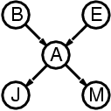
Cont…
Probability of the event that the alarm rings but neither a burglary nor an earthquake has occurred, and both Mary and John Call:
=P(J∧M∧A∧¬B∧¬E)
= P(J|A)P(M|A)P(A|¬B,¬E)P(¬B)P(¬E)
= 0.9 x 0.7 x 0.001 x 0.999 x 0.998
= 0.00062

Slide 31
Calculation of Joint Probability
Burglary
P(B)
0.001
Earthquake
P(E)
0.002
B | E | P(A|…)
TTFF | TFTF | 0.95 0.94 0.29 0.001
P(J∧M∧A∧¬B∧¬E)
= P(J|A)P(M|A)P(A|¬B,¬E)P(¬B)P(¬E)
= 0.9 x 0.7 x 0.001 x 0.999 x 0.998
= 0.00062
Alarm
JohnCalls
A | P(J|…)
TF | 0.90 0.05
MaryCalls
A | P(M|…)
TF | 0.70 0.01

Slide 32
Conditional Independence
Let {x₁,…, x_{n}} be any set of nodes in the network so that
P (x₁,…, x_{n})
= P(x_{n} |x₁,…, x_{n}) P(x_{n-1},…, x₁)
= P(x_{n} |x₁,…, x_{n}) P(x_{n-1}| x_{n-2}…, x₁)
…P(x₂|x₁)P(x₁)
=Π_{i=1,…,n}P(x_{i}|Parents(X_{i}))
The belief network represents conditional independence:
P(x_{i} |x_{i},…, x₁) = P(x_{i}|Parents(X_{i}))

Slide 33
What The BN Encodes
Burglary
Earthquake
Alarm
JohnCalls
MaryCalls
Each of the beliefs JohnCalls and MaryCalls is independent of Burglary and Earthquake given Alarm or ¬Alarm
The beliefs JohnCalls and MaryCalls are independent given Alarm or ¬Alarm
For example, John does
not observe any burglaries
directly

Slide 34
What The BN Encodes
Burglary
Earthquake
Alarm
JohnCalls
MaryCalls
Each of the beliefs JohnCalls and MaryCalls is independent of Burglary and Earthquake given Alarm or ¬Alarm
The beliefs JohnCalls and MaryCalls are independent given Alarm or ¬Alarm
Note that these reasons could
be other beliefs in the network.
The probabilities summarize these
non-explicit beliefs
For instance, the reasons why
John and Mary may not call if
there is an alarm are unrelated

Slide 35
Inference In BN
Set E of evidence variables that are observed, e.g., {JohnCalls,MaryCalls}
Query variable X, e.g., Burglary, for which we would like to know the posterior probability distribution P(X|E)
J
M
P(B|…)
T
T
?
Distribution conditional to
the observations made

Slide 36
Inference Patterns
Basic use of a BN: Given new
observations, compute the new
strengths of some (or all) beliefs
Burglary
Earthquake
Burglary
Earthquake
Alarm
Diagnostic
Alarm
Causal
JohnCalls
MaryCalls
JohnCalls
MaryCalls
Other use: Given the strength of
a belief, which observation should
we gather to make the greatest
change in this belief’s strength
Burglary
Earthquake
Burglary
Earthquake
Alarm
Intercausal
Alarm
Mixed
JohnCalls
MaryCalls
JohnCalls
MaryCalls

Slide 37
Examples
Lung Cancer Problem- Pollution and smoking are the factors those affect a patient’s chance of having cancer. Similarly, having cancer affects the patient’s breathing and the chances of having a positive X-ray result.
Metastatic cancer: Metastatic cancer is a possible cause of brain tumours and is also an explanation for increased total serum calcium. In turn, either of these could explain a patient falling into a coma. Severe headache is also associated with brain tumours.

Slide 38
Examples
Wet Pavement Problem- If the sprinkler is on, then the pavement is probably wet. If someone slips on pavement, it also provides evidence that the pavement is wet, that makes it more likely that the sprinkler is on or that it is raining.
Life expectancy Problem-It is known that whether or not a person has cancer is directly influenced by whether she is exposed to second-hand smoke and whether (s)he smokes. Both of these things are affected by whether her parents smoke. Cancer reduces a person’s life expectancy.

Slide 39
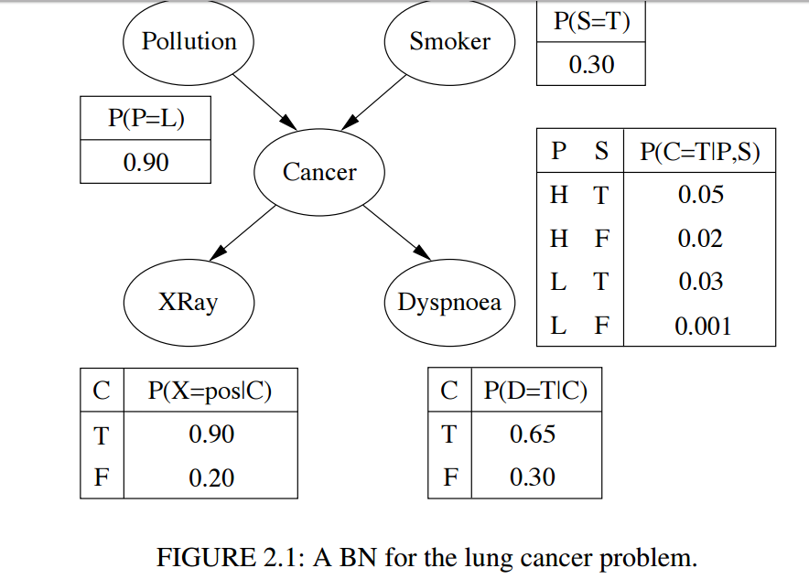
Lung Cancer Problem

Slide 40
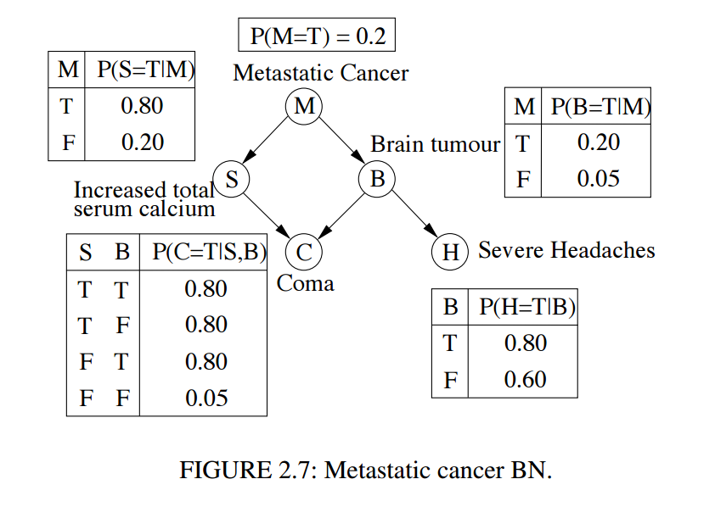
Metastatic cancer

Slide 41
Representing uncertainty is useful in knowledge bases.
Probability provides a framework for managing uncertainty.
Using a full joint distribution and probability rules, we can derive any probability relationship in a probability space.
Number of required probabilities can be reduced through independence and conditional independence relationships
Probabilities allow us to make better decisions by using decision theory and expected utilities.
Rational agents cannot violate probability theory.

Slide 42
References
Russel and Norving, “AIMA”, Second edition, PHI
“Introducing Bayesian Networks”, http://www.csse.monash.edu.au/bai/book/BAI_Chapter2.pdf, last retrieved on April 16,2017

Slide 43
THANK YOU

